Slide 1
Architectural Patterns to deploy Machine Learning scalable applications
Software Architecture Foundation
“We have some intuition that there are different kinds of software architectures, but we have not formalized, or institutionalized, them.” A.L. Wolf

Slide 2
Index
Real Case, how to find anomalies over inventory
Software Architecture and Bulding Architecture
Architectural Elements
Abstractions and Subsystems
Different Point of Views
Software Architecture Pillars
Common Architectures

Slide 3
“Hidden Technical Debt in Machine Learning Systems,” Google NIPS 2015
Data
Verification
Machine Resource Management
Data Collection
Serving
Infrastructure
Configuration
Monitoring
ML
Code
Analysis Tools
Feature Extraction
Process
Management Tools
Only a small fraction of real-world ML systems is composed of the ML code, as shown by the small green box in the middle. The required surrounding infrastructure is vast and complex.

Slide 4
Real life – Finding Anomalies over inventory
We are a big Logistic Company:
Each year we lose more than XX€ for delta inventory issues: the amount of real materials in warehouse is different to the logical (financial) one.
At the end of the year, we create correction movements to make these two amounts the same. This kind of checks is very expensive, we can make just once.
Please, we need a system able to detect when some behavior will lead to a correction at the end of the year:
How much it will cost?
Can you design and develop it?
When this system will be ready?

Slide 5
“Hidden Technical Debt in Machine Learning Systems,” Google NIPS 2015
(Data
Verification )
?
(Machine Resource Management )
?
(Data Collection )
?
(Serving
Infrastructure )
?
(Configuration)
?
(Monitoring)
?
Anomaly Detection
(Analysis Tools )
?
(Feature Extraction )
?
(Process
Management Tools )
?
Only a small fraction of real-world ML systems is composed of the ML code, as shown by the small green box in the middle. The required surrounding infrastructure is vast and complex.

Slide 6
Real life – Finding Anomalies over inventory
I want to build an anomaly detection tool to process plant inventory operations and predict frauds to save 60M€/year
Anomaly Detector
SAP
Azure Data Lake Store
Spark
Sap Connector
MongoDB
Tensorflow
asp.NET

Slide 7
Real life – Finding Anomalies over inventory
I need a technical database to store configurations and other technical information
Anomaly Detector
SAP
Azure Data Lake Store
Spark
Sap Connector
MongoDB
Tensorflow
asp.NET
MySQL

Slide 8
Real life – Finding Anomalies over inventory
This analysis should be done in real time…
Anomaly Detector
SAP
Azure Data Lake Store
Spark
Sap Connector
MongoDB
Tensorflow
Kafka
asp.NET
MySQL

Slide 9
Real life – Finding Anomalies over inventory
I would like to gather data from a Mainframe application used to manage stock
Anomaly Detector
SAP
Azure Data Lake Store
Mainframe
Spark
Sap Connector
DB2
Cobol
MongoDB
Perl
Web Scraping Integration
Tensorflow
Kafka
asp.NET
MySQL

Slide 10
Real life – Finding Anomalies over inventory
Maybe adding also people information we can refine the model. But Zucchetti only expose API…
Anomaly Detector
SAP
Azure Data Lake Store
Mainframe
Spark
Sap Connector
DB2
Cobol
MongoDB
Perl
Web Scraping Integration
Tensorflow
Kafka
asp.NET
REST API Integration
MySQL
Zucchetti

Slide 11
Real life – Finding Anomalies over inventory
And what about log of mission tracking application? Or data from the Manufacturing Execution System? We need an ETL
Anomaly Detector
SAP
MES
Azure Data Lake Store
Sql Server 2016
Java
Mainframe
Javascript
Spark
Sap Connector
DB2
Cobol
MongoDB
Perl
Web Scraping Integration
Mission Tracking
Tensorflow
SQL Server 2016
C#
ETL
Kafka
asp.NET
ASP.NET
REST API Integration
MySQL
Zucchetti

Slide 12
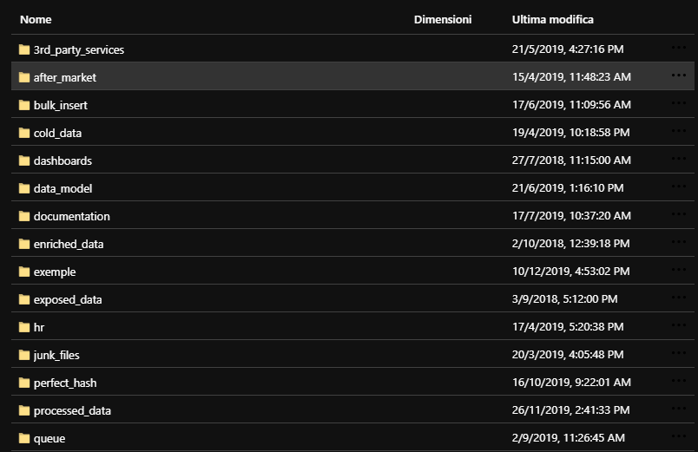
Real life – Finding Anomalies over inventory
Ops… now the Data Lake is a real mess…
Anomaly Detector
SAP
MES
Azure Data Lake Store
Sql Server 2016
Java
Mainframe
Javascript
Spark
Sap Connector
DB2
Cobol
MongoDB
Perl
Web Scraping Integration
Mission Tracking
Tensorflow
Elastic Search
Logstash
ETL
Kafka
asp.NET
Kibana
REST API Integration
MySQL
Zucchetti

Slide 13
Real life – Finding Anomalies over inventory
What if
I change the Data Lake Provider?
Or if SAP governance team change a table?
Or if Mainframe data are needed by other applications?
Or if…
Anomaly Detector
SAP
MES
Azure Data Lake Store
Sql Server 2016
Java
Mainframe
Javascript
Spark
Sap Connector
DB2
Cobol
MongoDB
Perl
Web Scraping Integration
Mission Tracking
Tensorflow
SQL Server
Logstash
ETL
Kafka
asp.NET
ASP.NET
REST API Integration
MySQL
Zucchetti

Slide 14
Do I need to know how to build a Software Architecture?
(Probably) Yes!

Slide 15
Foundations for the Study of Software Architecture / L. Wolf, 1992*
Software architecture principles can be inherited by appealing to several well-established architectural disciplines.
While the subject matter for the two is quite different, there are a number of interesting architectural points in building architecture that are suggestive for software architecture
multiple views
architectural styles
style and engineering
style and materials

Slide 16
Building an Architecture
Classical Architecture needs MULTIPLE VIEWS
A building architect works with the customer by means of a number of different views in which some particular aspect of the building is emphasized.
For example, there are elevations and floor plans that give the exterior views and “top-down" views, respectively.
The elevation views may be supplemented by contextual drawings or even scale models to provide the customer with the look of the building in its context.

Slide 17
Building an Architecture
Classical Architecture needs ARCHITECTURAL STYLE
Descriptively, architectural style defines a particular codification of design elements and formal arrangements.
Prescriptively, style limits the kinds of design elements and their formal arrangements.
That is, an architectural style constrains both the design elements and the formal relationships among the design elements.

Slide 18
Building an Architecture
Classical Architecture is based on STYLE AND ENGINEERING
Of extreme importance is the relationship between engineering principles and architectural style (and, of course, architecture itself ).
For example, one does not get the light, airy feel of the perpendicular style as exemplified in the chapel at King's College, Cambridge, from romanesque engineering.
Different engineering principles are needed to move from the massiveness of the romanesque to lightness of the perpendicular. It is not just a matter of aesthetics.

Slide 19
Building an Architecture
Classical Architecture is based on STYLE AND MATERIALS
The materials have certain properties that are exploited in providing a particular style. One may combine structural with aesthetic uses of materials, such as that found in the post and beam construction of tudor-style houses.
However, one does not build a skyscraper with wooden posts and beams.
The material aspects of the design elements provide both aesthetic and engineering bases for an architecture.

Slide 20
Architecture:
the art or practice of designing and building structures and especially habitable ones
a unifying or coherent form or structure
Webster's Ninth New Collegiate Dictionary

Slide 21
Lessons Learnt
Some of the more interesting focus point for Software Architecture can be inherited from the classical field of architecture:
multiple views are needed to emphasize and to understand different aspects of the architecture
styles are a cogent and important form of codification that can be used both descriptively and prescriptively style and engineering
engineering principles and material properties are of fundamental importance in the development and support of a particular architecture and architectural style

Slide 22
Software Architecture Pillars
Software Architecture must become:
the framework for satisfying requirements
the technical basis for design
the managerial basis for cost estimation and process management
an effective basis for reuse

Slide 23
Architecture Context
Project Execution
Implementation
Representations of the algorithms and data types that satisfy the design, architecture, and requirements
Design
Modularization and detailed interfaces of the design elements, their algorithms and procedures, and the data types needed to support the architecture and to satisfy the requirements
Architecture
Selection of architectural elements, their interactions, and the constraints to provide a framework in which to satisfy the requirements and serve as a basis for the design
Requirements
Determination of the information, processing, and the characteristics of that information and processing needed by the user of the system

Slide 24
Software Architecture:
A software architecture is a set of architectural elements that have a particular form.
[…]
The architectural form consists of weighted properties and relationships.
[…]
An underlying, but integral, part of an architecture is the rationale for the various choices made in defining an architecture
Wolf et Al., 1992

Slide 25
Software Architecture Elements
Components that contain the information that is used and transformed
Components that supply the transformation on the data elements
Properties are used to constrain the choice of architectural elements. They define the minimum desired constraints unless otherwise stated: by default on “what is not constrained by the architect may take any form desired by the designer or implementer"
Relationships are used to constrain the “placement" of architectural elements – how the different elements may interact and how they are organized with respect to each other in the architecture
Rationale is an underlying, but integral, part of an architecture for the various choices made in defining an architecture. It captures the motivation for the choice of architectural style, the choice of elements, and the form to satisfy the system constraints.
Properties are used to constrain the choice of architectural elements. They define the minimum desired constraints unless otherwise stated: by default on “what is not constrained by the architect may take any form desired by the designer or implementer"
Relationships are used to constrain the “placement" of architectural elements – how the different elements may interact and how they are organized with respect to each other in the architecture
Rationale is an underlying, but integral, part of an architecture for the various choices made in defining an architecture. It captures the motivation for the choice of architectural style, the choice of elements, and the form to satisfy the system constraints.
Components (which at times may be either processing or data elements, or both) are the glue that holds the different pieces of the architecture together
Connecting Elements
Connecting Elements
Data Elements
Data Elements
Processing Elements
Processing Elements

Slide 26
These new problems involve the system-level design of software, in which the important decisions are concerned with the kinds of modules and subsystems to use and the way these modules and subsystems are organized.
This level of organization, the software architecture level, requires new kinds of abstractions that capture essential properties of major subsystems and the ways they interact.
Shaw, 1989

Slide 27
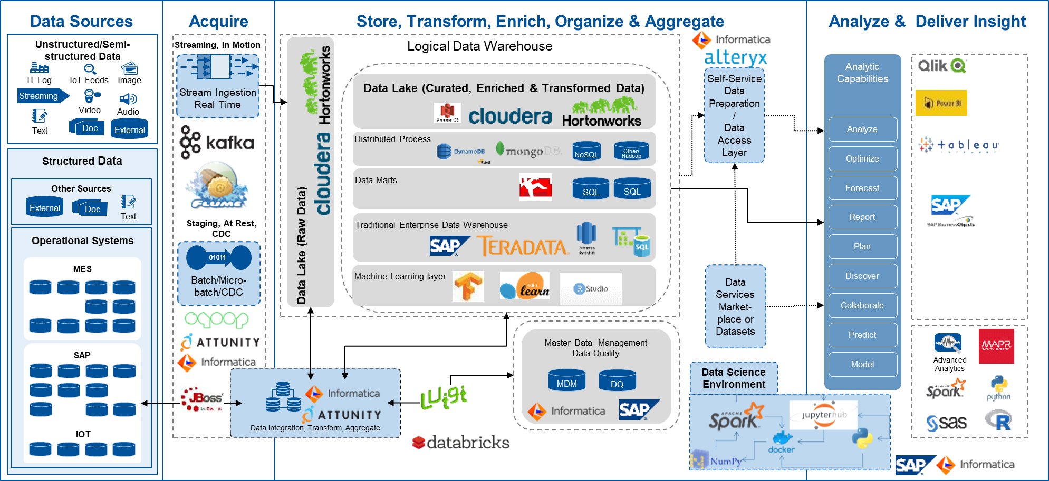
What an Architecture is…

Slide 28
What an Architecture is… not
List of technologies
List of vendors
A development stack
A fanboy war

Slide 29
Architecture as a framework for abstractions
The essence of abstraction is recognizing a pattern, naming and defining it, analyzing it, finding ways to specify it, and providing some way to invoke the pattern by its name without error-prone manual intervention
This process suppresses the details of the pattern’s implementation, reduces the opportunity for clerical error, and simplifies understanding of the result
In other words, good abstraction is ignoring the right detail at the right times.

Slide 30
“The development of individual abstractions often follows a common pattern:
First, problems are solved ad hoc.
As experience accumulates, some solutions turn out to work better than others, and a sort of folklore is passed informally from person to person.
Eventually the useful solutions are understood more systematically, and they are codified and analyzed.
This in turn enables a more sophisticated level of practice and allows us to tackle harder problems.”
Shaw, 1989

Slide 31
Example of Abstractions
Pipe & Filter - UNIX
Each module accepts a stream of inputs and emits a stream of outputs; usually the output stream involves local transformation of the input stream, making the module a filter.
F1(x)
F2(x)
F3(x)
stream1
stream2
stream3
stream4
Object Oriented Programming
Abstract data types provide a useful way to organize a software system: a number of independent objects (obj) invoke each others’ operations (op).
op
OBJ
op
op
op
op
op
OBJ
OBJ
op
OBJ
op
op
OBJ
op
op

Slide 32
Example of Abstractions
Layered Systems – OSI layers
Application
System organized hierarchically, with each layer providing service to the layer above it. Inner layers are usually hidden from outer layers, except for certain functions carefully selected for export
Presentation
Session
Transport
Network
Data Link
Physical
Rule Based Systems
Inputs
Rule
Base
Fact Memory
The computation is organized as an unordered collection of rules, each of which gives a condition under which the rule applies and an action to take when it does apply.
Working Memory
Outputs
Rule Interpreter
Rule & Data Element Selection

Slide 33
System-Subsystem Abstraction
Systems are constructed by combining subsystems:
independently compilable modules, linked by shared data or procedure calls
sets of design decisions and the code that implements them
Subsystems have an internal structure. It is often useful to design that substructure at an architectural level before implementing it
Each subsystem may performs:
a specific function to the system being implemented
a more common function such as communication or storage
Identifying and classifying the system functions that are common to many applications is a significant first step to the development of software architecture.

Slide 34
System-Subsystem Abstraction
Relations between subsystems (elements) can be obtained using different approaches:
sensitive to the implementation paradigm of individual units
invocation (e.g., of procedures)
instantiation (e.g., of generic definitions)
replication (e.g, of program text)
not sensitive to the implementation paradigm of individual units:
communication links
pipes

Slide 35
Since the technology permits distributing large amounts
of computing facilities in small packages to remote locations,
some kind of structure (or architecture) is imperative
because decentralization without structure is chaos.
Zachman, 1987

Slide 36
Zachman Framework - Building
Transcription of the owner’s perceptual requirements, a depiction of the final product from the owner perspective
Plan from the builder perspective. Technological and natural constraints could force the builder to change the original plan
Conceptual representation which depicts the size, shape, and basic intent of the final structure
Designer representation of the product: it puts an explicit specification to material composition of the final product
View for subcontractors. No more a contextual view, but only turn key elements to be built
Bubble Charts
Bubble Charts
Architect’s Drawing
Architect’s Drawing
Architect’s Plan
Architect’s Plan
Contractor’s Plan
Contractor’s Plan
Shop Plan
Shop Plan

Slide 37
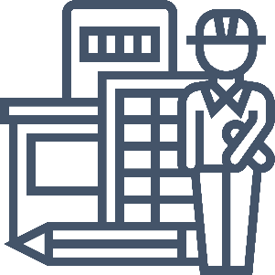
Multiple Views
Each perspective is not just a matter of different level of detail. It is linked with different natures and accountability.
The Owner needs the building for a specific purpose. He/she does not know how, but he/she knows perfectly why
The Architect needs to project and formalize something that fit completely with owner’s needs, to plan the what
The Builder needs to design how the what will be built matching with natural laws and technological costraints

Slide 38
Zachman Framework – Information System
Fit of the scope inside the customer business using customer terms
Description of technological choices to developers, w.r.t. actual costraints
System description and why it is going to be used by the final customer
Representation of the architecture w.r.t. the customer Information System
Description of each component completely
Scope
Scope
Business Description
Business Description
Information System Description
Information System Description
Technology Model
Technology Model
Detailed Description
Detailed Description

Slide 39
Multiple Descriptions
Each perspective is not just a matter of different level of detail. It is linked with different natures and accountability.
Input-Process-Output
Product description in detail w.r.t intended capabilities, appearance, and interactions with users
Functional Description
Process Model

Slide 40
Input-Process-Output (IPO)
A computer program using the input-process-output model receives inputs from a given source, process it doing some kind of computations, and returns the results.
Material
Bought (MB)
$${d(MB)}/{dt}$$
Material
Bought Speed
$$\frac{{d(MB)}/{dt}}{{d(MU)}/{dt}}$$
Flow
Leakage
Material
Used (MU)
$${d(MU)}/{dt}$$
Material
Used Speed

Slide 41
Multiple Descriptions
Each perspective is not just a matter of different level of detail. It is linked with different natures and accountability.
Input-Process-Output
Product description in detail w.r.t intended capabilities, appearance, and interactions with users
Functional Description
Process Model
Entity-Relationship-Entity
«Stuff things is made of», description of data in each building blocks.
Material Description
Data
Model

Slide 42
Entity-Relationship Model (E-R model)
An entity–relationship model (or ER model) describes interrelated things of interest in a specific domain of knowledge. A basic ER model is composed of entity types (which classify the things of interest) and specifies relationships that can exist between entities (instances of those entity types).
Raw Material
Is-made-by
Semi-finished Product
Is-made-by
Finish Good
n
1
n
1
Item-ID
Date
Weight
Part-NBR
…
Customer

Slide 43
Multiple Descriptions
Each perspective is not just a matter of different level of detail. It is linked with different natures and accountability.
Input-Process-Output
Product description in detail w.r.t intended capabilities, appearance, and interactions with users
Functional Description
Process Model
Entity-Relationship-Entity
«Stuff things is made of», description of data in each building blocks.
Material Description
Data
Model
Node-Line-Node
Flows between each component
Location Description
Network Model

Slide 44
Node Line Node
A flow diagram represents subsystems connections
MES
Azure Data Lake Store
High Perf Cache
Presentation Layer
Sql Server 2016
Java
Spark
Javascript

Slide 45
Coming back to real world…

Slide 46
Architecture to find anomalies over inventory
SAP
Data Integration Layer
Message Bus
Data Layer
Integration
Module
Integration
Module
Data
Reader
Azure Data Lake Store
Data Exposer
MES
Connect
Connect
Sql Server 2016
Java
Get Delta
Get Delta
API Put
Technical Data
API Get
Javascript
Parse
Parse
Serialize
Serialize
Mainframe
Topic Subscriber
High Perf Cache
API Get
Integration
Module
Integration
Module
DB2
Cobol
Connect
Connect
Perl
Get Delta
Get Delta
Computation Layer
Mission Tracking
Parse
Parse
Read
Spark
Write
Serialize
Serialize
Sql Server 2016
C#
Read
Tensorflow
Write
Integration Module
ASP.NET
Connect
Get Delta
Presentation Layer
Parse
Serialize
Get Info
ACL
Anomaly
Zucchetti
Get Data
Session
Drill Down

Slide 47
Software Architecture Pillars
Software Architecture must become:
the framework for satisfying requirements
the technical basis for design
the managerial basis for cost estimation and process management
an effective basis for reuse
…

Slide 48
Software Architecture must become:
1. the framework for satisfying requirements
Will I be able to identify anomalous behavior?
Real time and batch ingestion layer to get data
Incremental data extraction strategy to avoid to reduce legacy system performances
Processing Layer to identify anomalies
Will I be able to add new sources of data?
Data integration is layered and wrapped
Data to be processed is always serialized in the same way
Reading and writing of each layer is always wrapped
Will I be able to change service provider?
Every external service is called through an external put/get decoupling strategy

Slide 49
Software Architecture must become:
2. the technical basis for design
Every layer is defined
Contracts between layers are defined
Abstract Modules describe complex components

Slide 50
Software Architecture must become:
3. the managerial basis for cost estimation and process management
Layer | Activity | Effort
Data Integration Layer | Develop Abstract Classes | 15 Mandays
Data Integration Layer | Implement Serialization Class | 5 Mandays
Data Integration Layer | Implement SAP Integration Module – Connect, Parse, Get Delta | 25 Mandays
Data Integration Layer | Configure SAP tables to be extracted | 1 Manday/table
Data Integration Layer | Implement SQL Server Integration Module – Connect, Parse, Get Delta | 15 Mandays
Data Integration Layer | Configure SQL Server Integration Module for MES | 10 Mandays
Data Integration Layer | Implement Mainframe Integration Module – Connect, Parse, Get Delta | 40 Mandays
Data Integration Layer | Implement REST API Integration Module – Connect, Parse, Get Delta | 15 Mandays
Data Integration Layer | Configure API Integration Module for Zucchetti | 10 Mandays
Data Integration Layer | Implement SQL Server Integration Module – Connect, Parse, Get Delta | 15 Mandays
Data Integration Layer | Configure SQL Server Integration Module for Mission Tracker | 10 Mandays
… | … | …

Slide 51
Software Architecture must become:
3. the managerial basis for cost estimation and process management
Data Integration Layer
Data Layer
Architects Team
Abstract Classes
Integration
Module
Integration
Module
Data
Reader
Azure Data Lake Store
Data
Exposer
Connect
Connect
Get Delta
Get Delta
Data Engineer Team
API Put
Technical Data
API Get
Parse
Parse
Serialize
Serialize
Integration Team 1
Topic Subscriber
High Perf Cache
API Get
Integration
Module
Integration
Module
Message Bus
Connect
Connect
Get Delta
Get Delta
Computation Layer
Parse
Parse
Integration Team 2
Read
Spark
Write
Serialize
Serialize
Data Science Team
Read
Tensorflow
Write
Integration Module
Connect
Get Delta
App Dev Team
Presentation Layer
Parse
Serialize
Get Info
ACL
Anomaly
Get Data
Session
Drill Down

Slide 52
Software Architecture must become:
4. an effective basis for reuse
Re-use
Reuse is possible when there is a clear understanding the concepts embodied in the architecture: the primary focus in architecture is the identification and documentation of most important choices
The architect, designer, or implementer may be able to select the appropriate architectural element or implemented code to satisfy the specified constraints at the appropriate level
The important lesson in reusing components is that the possibilities for reuse are the greatest at the architectural level - where specifications for the components are constrained the least: otherwise it could be too late because such elements often embody too many constraints

Slide 53
Software Architecture must become:
4. an effective basis for reuse
Data Integration Layer
Data Integration Layer
Integration
Module
Integration
Module
Integration
Module
Integration
Module
Connect
Connect
SQL Server DLL
Connect
Custom Connect
Get Delta
Get Delta
Get Delta
Get Delta
Parse
Parse
REST API Get Wrapper
Parse
Parse
Abstract Class
Serialize
Serialize
Serialize
Serialize
Connect
Integration
Module
Integration
Module
Get Delta
Time Based Delta
Integration
Module
Integration
Module
Connect
Connect
Parse
CustomConnect
Connect
Get Delta
Get Delta
Serialize
Data Lake Serializer
Get Delta
Get Delta
Parse
Parse
Parse
Parse
Serialize
Serialize
Serialize
Serialize
Integration Module
Integration Module
Connect
Get Delta
Connect
Get Delta
Parse
Serialize
Parse
Serialize

Slide 54
Software Architecture Pillars
Software Architecture must become:
the framework for satisfying requirements
the technical basis for design
the managerial basis for cost estimation and process management
an effective basis for reuse
unique point of security and data centralization
the framework for enhancing productivity and security
…

Slide 55
Software Architecture must become:
5. unique point of security and data centralization
Data is store in a single place to achieve a single point of truth scenario
Access to data in Data Layer is always marshalled by architectural elements, ensuring
No data can be replicated (the writing modules path-to-use is not decided by theirself but by architecture)
Access level is always managed in a single point

Slide 56
Software Architecture must become:
6. the framework for enhancing productivity and security
Data Integration Layer
20 Components
to develop
Data Integration Layer
4 Re-usable Components to develop
9 Custom Components to develop
11 Components to use
Integration
Module
Integration
Module
Integration
Module
Integration
Module
Connect
Connect
SQL Server DLL
Connect
Custom Connect
Get Delta
Get Delta
Get Delta
Get Delta
Parse
Parse
REST API Get Wrapper
Parse
Parse
Abstract Class
Serialize
Serialize
Serialize
Serialize
Connect
Integration
Module
Integration
Module
Get Delta
Time Based Delta
Integration
Module
Integration
Module
Connect
Connect
Parse
CustomConnect
Connect
Get Delta
Get Delta
Serialize
Data Lake Serializer
Get Delta
Get Delta
Parse
Parse
Parse
Parse
Serialize
Serialize
Serialize
Serialize
Integration Module
Integration Module
Connect
Get Delta
Connect
Get Delta
Parse
Serialize
Parse
Serialize

Slide 57
Software Architecture must become:
6. the framework for enhancing productivity and security
Data Integration Layer
Data Layer
Architects Team
Abstract Classes
Integration
Module
Integration
Module
Data Lake Batch Wrapper
Azure Data Lake Store
Data Lake Data Exposer
Connect
Connect
Get Delta
Get Delta
Data Engineer Team
A single team is accountable
for security but with complete control
over any choice and over any process
API Put
Technical Data
API Get
Parse
Parse
Serialize
Serialize
Integration Team 1
Topic Subscriber
High Perf Cache
API Get
Integration
Module
Integration
Module
Data Transport Bus
Connect
Connect
Get Delta
Get Delta
Computation Layer
Parse
Parse
Integration Team 2
Read
Spark
Write
Serialize
Serialize
Data Science Team
Read
Tensorflow
Write
Integration Module
Connect
Get Delta
App Dev Team
Presentation Layer
Parse
Serialize
Get Info
ACL
Anomaly
Get Data
Session
Drill Down

Slide 58
Software Architecture Pillars
Software Architecture must become:
the framework for satisfying requirements
the technical basis for design
the managerial basis for cost estimation and process management
an effective basis for reuse
unique point of security and data centralization
the framework for enhancing productivity and security
the platform to allow applications integration
the strategy to allow scalability and to control software processes execution
the strategy to avoid handover

Slide 59
Architectural Threats
Systems evolve and are adapted to new uses, just as buildings change over time and are adapted to new uses.
But you should be very careful about:
Architectural erosion: sometimes the original architecture evolve in a way it was out of original plans, when new elements are added with no respect. This kind of violations of the architecture can lead to an increase in problems in the system
Architectural drift: sometimes the architecture is not understood completely, due to insensitivity about the rationale. This insensitivity leads more to inadaptability than to disasters and results in a lack of coherence and clarity of form. The less the architecture is clear, the easier is to erode the architecture.

Slide 60
Architecture Style
Architectural Style encapsulates important decisions about elements and emphasizes important constraints on them and their relationships.
We can use Architecture Style both to constrain the architecture and to coordinate cooperating architects.
Moreover, style embodies those decisions that suffer erosion and drift: an emphasis on it as a constraint on the architecture provides a visibility to certain aspects of the architecture so that violations of those aspects and insensitivity to them will be more obvious.

Slide 61
Enterprise Architecture Styles
1990 - Common Object Request Broker Architecture - CORBA “Framework to allow objects hosted in different systems to make remote procedures call via a computer network using an Object Request Broker which marshals and serializes these requests”
2003 - Service Oriented Architecture - SOA “Framework for integrating business processes and supporting IT infrastructure as secure, standardized components—services—that can be reused and combined to address changing business priorities” Bieberstein, Bose et al. 2005
2012 – Microservices
2004 - Message Oriented Architecture - MOM “Framework to allow objects hosted in different systems to send messages via a computer network using a Message Broker to distribute Applications modules over heterogeneous platform”
…

Slide 62
CORBA Model
Object Request Broker - enables objects to transparently make and receive requests and responses in a distributed environment. It is the foundation for building applications from distributed objects and for interoperability between applications in hetero- and homogeneous environments. The architecture and specifications of the Object Request Broker are described in this manual.
Object Services - a collection of services (interfaces and objects) that support basic functions for using and implementing objects. Services are necessary to construct any distributed application and are always independent of application domains. For example, the Life Cycle Service defines conventions for creating, deleting, copying, and moving objects; it does not dictate how the objects are implemented in an application. Specifications for Object Services are contained in CORBAservices: Common Object Services Specification.
Common Facilities - a collection of services that many applications may share, but which are not as fundamental as the Object Services. For instance, a system management or electronic mail facility could be classified as a common facility. Information about Common Facilities will be contained in CORBAfacilities: Common Facilities Architecture.
Application Objects - products of vendors or in-house development group(s) that control their interfaces. Application Objects correspond to the traditional notion of applications, so they are not standardized by OMG. Instead, Application Objects constitute the uppermost layer of the Reference Model.

Slide 63
SOA Model
Service – core building blocks of any SOA implementation. It is defined through a Service Name and Service Description outside the Service implementation itself. A Message In can be used to pass configuration at run time, even DLL, and a Message Out is used to give back the execution status.
Enterprise Service Bus – high-level protocol communication system between mutually interacting software applications in a SOA.
Service Broker – agent able to submit any service to the right application server to be executed. It is both technology and implementation agnostic. It is able to execute a Service having just the knowledge about its name and the Message In
Service Queue – Queue - technically a table - where the status of each service can be checked. It could be used to run syncronous and asyncronous services. Service Broker can read this queue with different strategies and dequeue it.

Slide 64
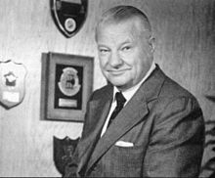
Keep It Simple, Stupid! KISS principle
“Most systems work best if they are kept simple rather than made complicated; therefore, simplicity should be a key goal in design, and unnecessary complexity should be avoided”
Kelly Johnson, 1960

Slide 65
Some Enterprise Architecture Patterns
1990 - Common Object Request Broker Architecture - CORBA “Framework to allow objects hosted in different systems to make remote procedures call via a computer network using an Object Request Broker which marshals and serializes these requests”
2003 - Service Oriented Architecture - SOA “Framework for integrating business processes and supporting IT infrastructure as secure, standardized components—services—that can be reused and combined to address changing business priorities” Bieberstein, Bose et al. 2005
2012 – Microservices
2004 - Message Oriented Architecture - MOM “Framework to allow objects hosted in different systems to send messages via a computer network using a Message Broker to distribute Applications modules over heterogeneous platform”
…

